Slide 1
3. MCM-6 Good Housekeeping at Municipal Facilities:
Fleet Maintenance
Green Country Stormwater Alliance (GCSA)
Employee Training Series
Prepared by INCOG
March 2021
Notes:
This is the 3rd of 6 annotated PowerPoint (aPPT) Modules covering MCM-6 “Good Housekeeping” employee training.
This module covers maintenance of the municipally-owned fleet of vehicles and heavy equipment.
Permitted MS4s, particularly cities, operate vehicle and heavy equipment (fleet) maintenance facilities.
Maintenance activities can contribute pollution in stormwater runoff, so Best Management Practices (BMPs) must be implemented to control pollution at its source.

Slide 2
Fleet Maintenance Topics
This presentation provides suggestions for controlling runoff pollution for the following activities:
  General Guidelines
  Leaks and Spills
  Disposal Methods
  Parts Cleaning
  Shop and Pavement Cleaning
  Fueling
  Washing
Notes:
OKR04’s “Good Housekeeping” 6th Minimum Control Measure (MCM-6) requires city employees to set a good example for the community.
The general public is always watching, and as your stormwater educational outreach program informs them of good and bad practices, they become watchdogs.
You don’t want to be violating good housekeeping practices that you expect them to follow.
There are many activities you do regarding vehicle and equipment maintenance that can contribute pollutants in stormwater runoff.
These include leaks and spills, improper cleanup and disposal of wastes, parts cleaning, general shop cleaning, fueling areas and vehicle and equipment washing.
This presentation will look at particular aspects of each of these to identify ways pollutants can be controlled at municipal facilities.

Slide 3
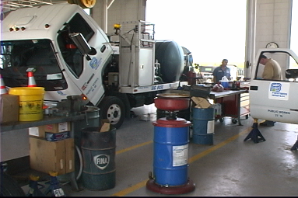
General Guidelines
Thoroughly train employees in storm water regulations and the safe handling and disposal of workplace chemicals.
Conduct all vehicle and equipment maintenance at designated locations.
The preferred location is inside the shop or outdoors on a paved, covered surface.
Notes:
DEQ’s MS4 Audit Checklist includes verifying that the MS4 has a “BMP technical guidance document available to maintenance staff”.
While the OKR04 stormwater permit does not address personal safety directly, the requirements for proper chemical storage, use and disposal include many types of safety practices.
OKR04 does require employee training in the proper storage, use and disposal of chemicals as well as spill cleanup.
Little spills and leaks are much easier to cleanup when they occur on impervious surfaces (hard surfaces such as concrete and asphalt that do not absorb liquids).
Designated locations should have spill kits and recycling receptacles, and employees should be trained on when and how to use them.

Slide 4
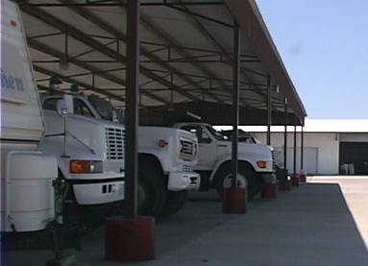
General Guidelines
Park damaged, leaking, or dirty vehicles under cover, if possible, to prevent exposure to rainfall.
Contain leaking fluids, and use a chemical absorbent if necessary to transfer the material to the appropriate waste container.
Notes:
Vehicles left exposed to rainfall will result in vehicle fluids and sediments being washed off into storm drains or creeks.
OKR04 requires all chemicals in runoff to be captured or absorbed and disposed of before they get swept into a stormwater system.
The easiest way to avoid chemicals becoming stormwater pollutants is to park vehicles and equipment under shelters to avoid rainfall contact.

Slide 5
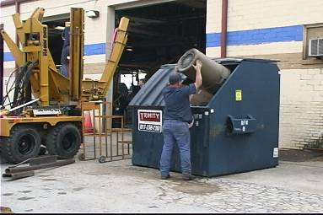
General Guidelines
Maintain a paper trail showing that proper handling and disposal practices are being followed. This includes:
Purchase records
Disposal records
Testing data
Licensing information
Shipping records
Notes:
Documenting how much material you purchased, how much was used, and how materials were disposed of will allow you to account for these materials.
If your records show the purchase of a large quantity of material, but the disposal of only a small amount, this indicates that improper disposal may have occurred.
Discrepancies in records can indicate the potential of improper disposal of chemicals.
While not a common practice, results of any chemical lab tests or field test kit data on stored chemicals should be kept, preferably with the Safety Data Sheets.
If you are using a shipping company, verify and keep records that they are licensed to transport the materials you are sending with them.
Also, maintain records of all materials and wastes that you ship via a third party hauler or product disposal service.
You will be held accountable for the actions of any third party to which you assign waste transport and disposal responsibility.

Slide 6
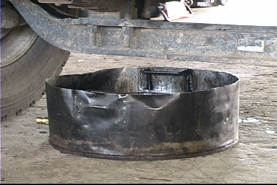
General Guidelines
Keep maintenance areas clean by promptly disposing of trash, debris, old parts and absorbents used on spills.
Promptly dispose of fluids that have been collected in drip pans or other open containers.
Notes:
All areas of work on vehicles and equipment should be clean and free of accumulations of trash, debris, spills and open chemical containers.
Prompt attention to site management must be second-nature and never allowed to grow into unmanageable and unsafe conditions.
Spill cleanup absorbents and liquids in drip pans and other containers need immediate attention for proper disposal.
Liquids should be recycled as much as possible. This is especially true of antifreeze, crank case oil, cutting fluids, solvents, oil-based paints, and other recyclable materials.
Non-recyclable materials should receive proper disposal. Your facility should have formal written procedures for proper disposal options of each material type.
If you are uncertain about the proper disposal option to use, contact your supervisor.

Slide 7
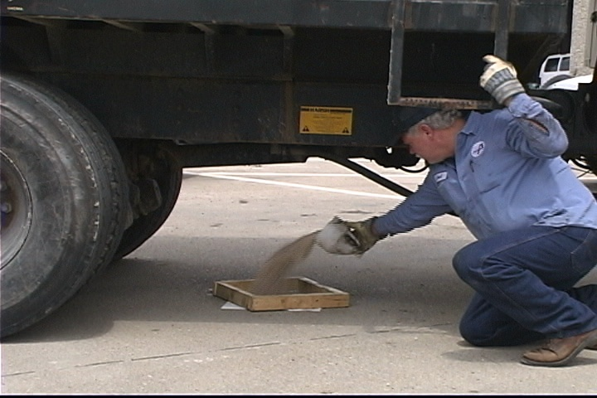
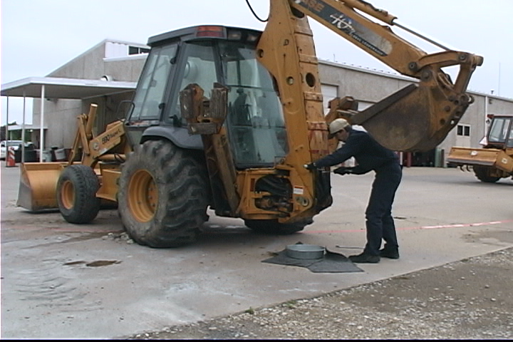
Leaks and Spills
Regularly inspect for leaks or stains around vehicles and equipment. Use a drip pan or absorbent material to collect dripping fluids.
Locate the source of leakage and stop further spillage by fixing the leak or draining the fluid.
Notes:
DEQ’s MS4 Audit Checklist requires that the facility be inspected for leaks and spills.
Checklist forms work well for conducting inspections. They are easier to use and maintain data quality over a long period of time by covering the same inspection items.
If your local inspections find numerous fresh oil or chemical spills, it indicates that “good housekeeping” practices are not being followed.
Develop a checklist form that best suits your local facility.
Include notes of observations and check the items off as you go through your inspection.

Slide 8
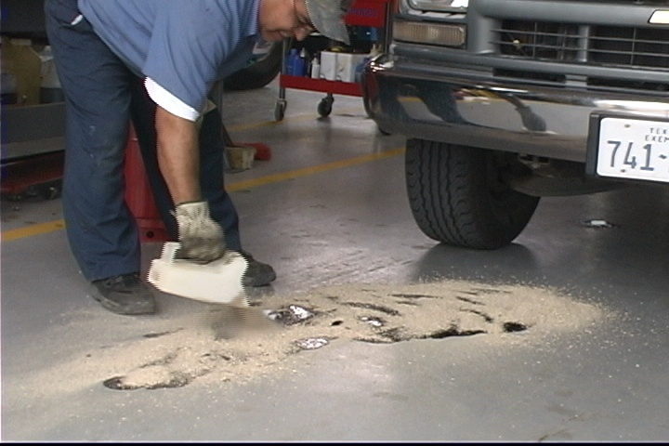
Leaks and Spills
Clean up spills immediately to minimize safety hazards and deter spreading.
Store cracked batteries in a leak proof container.
Prepare written local guidance on materials storage, spill cleanup and disposal methods to cover all of your local practices.
Notes:
Spills left in place not only pose a pollution problem, but often they are a personal safety problem.
Oils and other liquids on concrete create slick spots that can be a safety hazard.
Liquids can be tracked outside by shoes and tires which can then be washed into creeks during rainfall.
Many workplace chemicals, such as battery acid, are very corrosive and/or toxic.
Spilled chemicals can easily be dispersed as aerosols onto skin and into eyes resulting in tissue damage.
Prepare written procedures on the acceptable cleanup and disposal practices for all workplace chemicals.

Slide 9
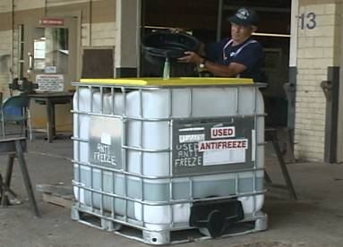
Disposal Methods
Collect all used motor oil, anti-freeze, transmission fluid and hydraulic fluid and store them in separate containers by type.
Make sure storage containers are properly labeled.
Segregating materials prevents cross-contamination and enhances recycling.
Notes:
Recycle as many types of materials as possible.
Do not mix different types of chemicals together in storage containers; blending of different chemicals generally prevents either from being recycled.
Mixing chlorinated and non-chlorinated solvents or different materials can greatly increase your disposal costs.
Containers used for storage of recyclable materials or for disposal should be clearly marked as such.
For example, notice the clear “USED ANTIFREEZE” labeling on the container in Slide 9.

Slide 10
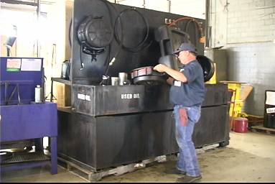
Disposal Methods
Some fleet maintenance products are considered hazardous under RCRA regulations.
Placards on vehicles and buildings and special handling measures may be necessary.
Disposal of hazardous waste typically requires special shipping papers (manifests), the use of a licensed transporter and a permitted disposal site.
Notes:
Remember, the waste is yours, “cradle to grave.” Once your purchased chemical can no longer be used, it becomes a waste, and you are its “Generator”.
Regardless of to whom you contract for waste disposal, you as the “Generator” have ultimate liability over the final disposal of the waste.
If one of your barrels shows up in the river or in an unpermitted landfill, you may get a bill for the clean-up of your portion of the improper disposal.
A “Manifest” is a formal document that tracks the originator of the waste to its ultimate legal and proper safe disposal.
Make sure the transport vehicles of your licensed waste hauling contractor have the proper placards.
Placards on building entrances can alert fire and emergency responders to potential hazards in the building in the event of an emergency.
Your supervisor will know which chemical wastes, if any, in your workplace fall under the requirements of the Resource Conservation and Recovery Act (RCRA).

Slide 11
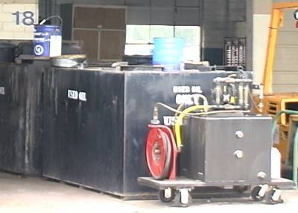
Disposal Methods
Track inventory to avoid the accumulation of expired or unusable materials.
If possible, recycle used fluids, oil, transmission and hydraulic filters and batteries.
Never dispose of used fluids in the trash.
Some used filters and batteries could be considered hazardous waste.
Notes:
Landfills generally do not allow fluids or liquids. These liquids become the leachate that may later contaminate groundwater.
The best way to keep track of all the various chemicals you own is to create a formal tracking system.
This includes information on initial purchase, where stored, quantities used over time, and ultimate disposal of used materials and wastes.
Recycle as many different materials as you can, including vehicle and equipment fluids, batteries, cutting oils, paints and solvents.
Disposal of liquid wastes into dumpsters and trash leads to leaks which will end up as pollutants in runoff.
Check with your supervisor on proper disposal methods, and be certain that your waste materials are not covered by RCRA rules.

Slide 12
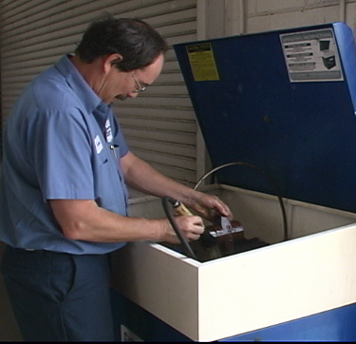
Parts Cleaning
Clean parts indoors and properly dispose of fluids, grease, dirt and other debris cleaned from these parts.
Allow parts to fully drain before removing from the cleaning sink to reduce dripping of cleaning fluid to the floor.
Keep lids closed on parts cleaning sinks when not in use.
Notes:
The safest way to clean dirty mechanical parts is dry-brushing before adding solvents and oils.
The person in Slide 12 has no personal safety gear: no goggles or face shield, no chemical resistant apron or gloves, and maybe even no first aid kits or eye wash.
Dirty parts should be cleaned indoors to avoid any materials being carried away in rainfall runoff.
Use cleaning methods that minimize quantity of solvents, and allow parts to drain into tray.
Keep solvent tray lid closed when not in use to avoid accidental splashing.

Slide 13
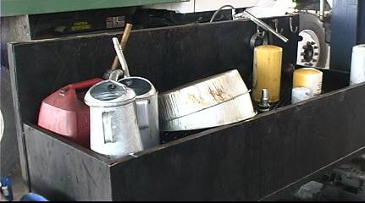
Parts Cleaning
Mechanically clean parts by dry brushing or wiping before using a solvent or water based cleaner.
A two part solvent cleaning process first using a dirty solvent, then a cleaner solvent may reduce the amount of solvent used.
Notes:
You may avoid use of solvents altogether if dry brushing alone will accomplish the cleaning needed.
Separate cleaning tasks into stages. First clean the majority of the debris from the part in one basin and then finish cleaning in a second basin that is cleaner.
This will reduce the amount of cleaning solvent used overall.
The first basin can be dirtier and still be effective since the final cleaning will be in a cleaner solution.
When the first basin gets too dirty to use, dispose of only that solvent. The second basin now becomes the dirtier basin.
You will be able to use the cleaner longer (less waste and a cost saving) and have cleaner parts when finished.

Slide 14
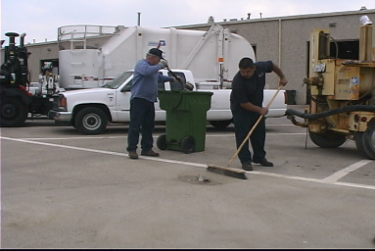
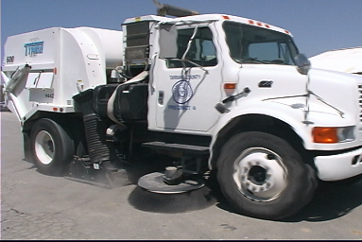
Shop and Pavement Cleaning
Use dry methods (sweeping, wiping, absorbents) to clean work areas as often as possible.
Dispose of mop water properly. It is usually acceptable to pour it down a sanitary sewer drain.
Notes:
DEQ’s MS4 Audit Checklist asks: “Are parking lots owned/operated by the permittee swept?” “At what frequency?”
When sweeping drives and walks, waste solids such as dry absorbents used on liquid spills, should be disposed of properly, usually in the trash.
Consult your supervisor for the acceptable methods of disposal.
Do not hose off hard surfaces with water, and do not place any waste materials into creeks, gutters or storm drains.
Mop water can usually be poured into a sanitary sewer drain on the property, but never into storm drains or gutters.
Check with your supervisor if you are not certain if the floor drain connects to the sanitary sewer or just flows to a nearby creek.

Slide 15
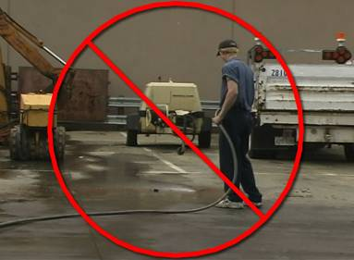
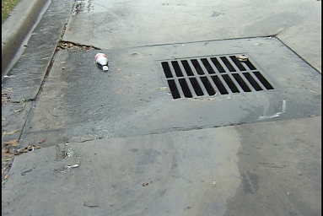
Shop and Pavement Cleaning
Don’t hose down outside work areas.
In addition to regular, periodic cleaning, clean outside work areas when rain is in the forecast.
Notes:
Hosing down outside work areas just moves the pollutants to the stormwater system and eventually to local waterways as polluted runoff.
Storm drains do not connect to sanitary sewers; there is no treatment for stormwater.
Avoid hosing down parking lots, sidewalks and other hard surfaces; dry sweep them instead.
A rain forecast should trigger a general cleanup of outside storage areas to minimize contact with rainfall and pollutants in runoff.

Slide 16
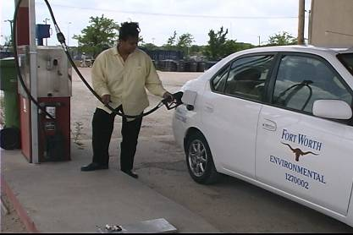
Fueling
To prevent overfilling and spills, don’t top off the fuel tank or leave a vehicle being fueled unattended.
Know where the emergency pump shut-off button is located.
Keep absorbent materials on site for use in prompt cleanup of spills.
Notes:
Vehicle and heavy equipment fueling sites can be significant contributors of pollution in stormwater runoff.
Spills of gasoline and diesel during tank filling should be cleaned up immediately with dry absorbents.
Don’t leave pumping unattended; overflows can result in large quantities of fuel being spilled on the ground.
Most fuel pumps and tanks have emergency shutoff valves; know where these are and how to use them.
Report any observed leaks from tanks, pumps, hoses or containment structures to your supervisor.

Slide 17
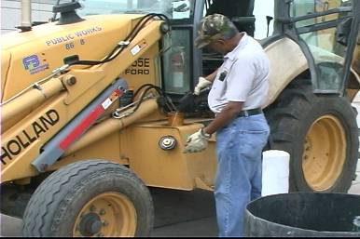
Fueling
Periodically clean fueling areas using approved methods to remove accumulated fuel and grease.
Fuel equipment at designated fueling areas rather than using mobile fueling.
If mobile fueling is used, keep a spill kit on the fuel truck.
Notes:
There will always be times when spills and leaks occur in fueling areas. Clean fueling area spills as soon as possible after the incident.
Follow your local written procedures for spill cleanup and disposal of waste materials.
Minimize the use of mobile fueling.
If mobile fueling is used, have spill kits on board.

Slide 18
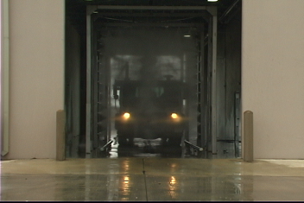
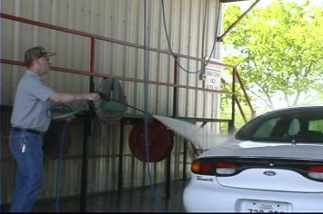
Washing
Wash equipment and vehicles ONLY in designated facilities where the wash water drains to the sanitary sewer system or is collected and recycled.
Notes:
Washing of vehicles and equipment should only be done in designated wash areas that drain to the sanitary sewer or where it is collected for recycling.
Wash water from these facilities may go through an oil and grease trap before flowing to the wastewater treatment plant.
This pre-cleaning process keeps the pollutants out of the stormwater drainage system.
Avoid washing vehicles and equipment in driveways or streets where wash water flows into gutters or storm drains.

Slide 19
Safety and the Workplace
For detailed answers to questions concerning safety and the workplace, contact:
Oklahoma Department of Labor
OSHA Consultation Division
https://www.ok.gov/odol/Workplace_Safety_&_Health/OSHA_Consultation_Services/index.html
Notes:
The safe handling of chemicals and hazardous materials in general should be taken seriously to avoid unnecessary injuries.
The Oklahoma Department of Labor has an internet site (see Slide 19) for information about safety in the workplace.

Slide 20



End of Module 3 on
Fleet Maintenance
Vernon Seaman
Manager, Envir. And Energy Planning
INCOG
Two West 2nd Street, Ste 800
Tulsa, OK 74103
(918) 579-9451
vseaman@incog.org
Notes:
This concludes the 3rd of 6 annotated PowerPoint (aPPT) Modules for local MCM-6 training.
Training Presentations 2 through 5 cover the training subjects listed in the OKR04 permit.
The final Presentation 6 covers additional facilities that may be owned by GCSA Members.
INCOG expects to be able to return to physical half-day GCSA Employee Training Workshops in the second half of 2021.
In this interim period, INCOG will continue to prepare annotated PowerPoints (aPPTs) for local staff training use.

